Slide 1
CAPSTONE
DALLAS CUSTOM AUTO PARTS
SMU Bootcamp . Amber Gipson . August 2019

Slide 2
What’s the application?
https://smu.bootcampcontent.com/SMU-Coding-Bootcamp/SMU-DAL-FSF-FT-06-2019-E-C/blob/master/week-06/project-requirements.md

Slide 3
How did I go about building it?
ORDER TABLE
PRIMARY KEY
orderID()
FOREIGN KEY
partID()
vendorID
startDate()
endDate()
price()
quantity()
total()
partName()
partType()
INVENTORY TABLE
PRIMARY KEY
partID()
FOREIGN KEY
vendorID()
partName()
partType()
quantity()
price()
status()
VENDORS TABLE
PRIMARY KEY
vendorID()
firstName()
lastName()
email()
phoneNumber()

Slide 4
Why did I build the application this way?

Slide 5
Demonstration

Slide 6



Did I meet expectations?

Slide 7
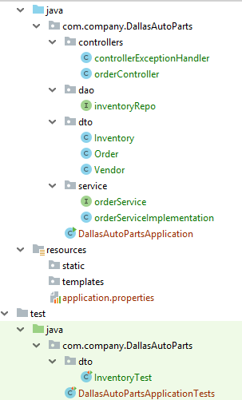
DTOS
DAO
SERVICE LAYER
CONTROLLER
EXCEPTION HANDLER

Slide 8
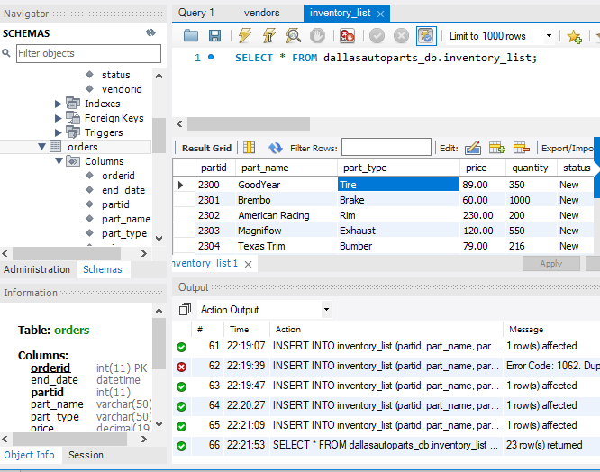
VENDOR TABLE
INVENTORY TABLE

Slide 9

SQL Database
(I FIGURED IT OUT!)
& TDD
KISS, better planning
Test code
Search Erros
Research / Development
What challenges did you run into?
How did you overcome them?
What improvements would you make next?

Slide 10


